Slide 1
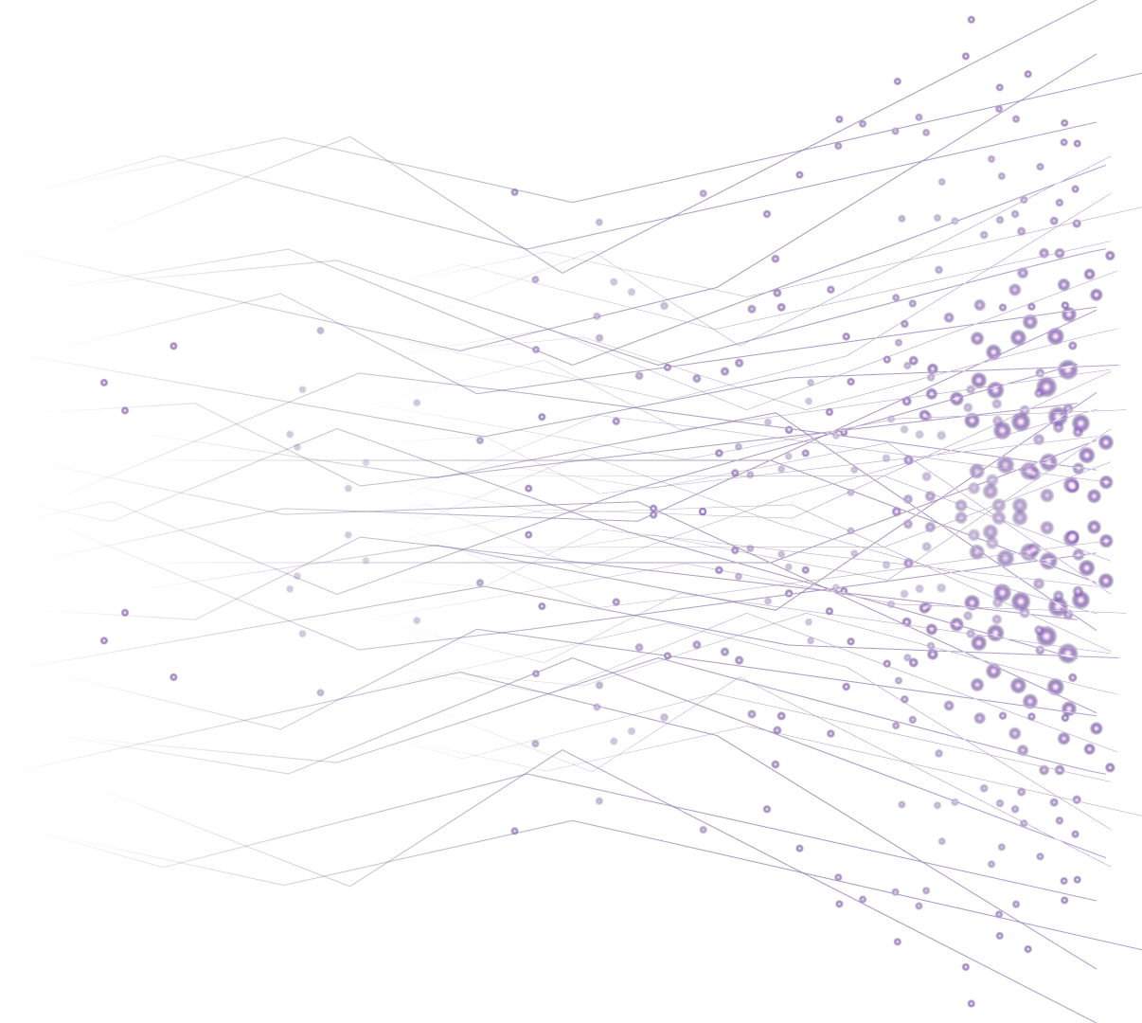

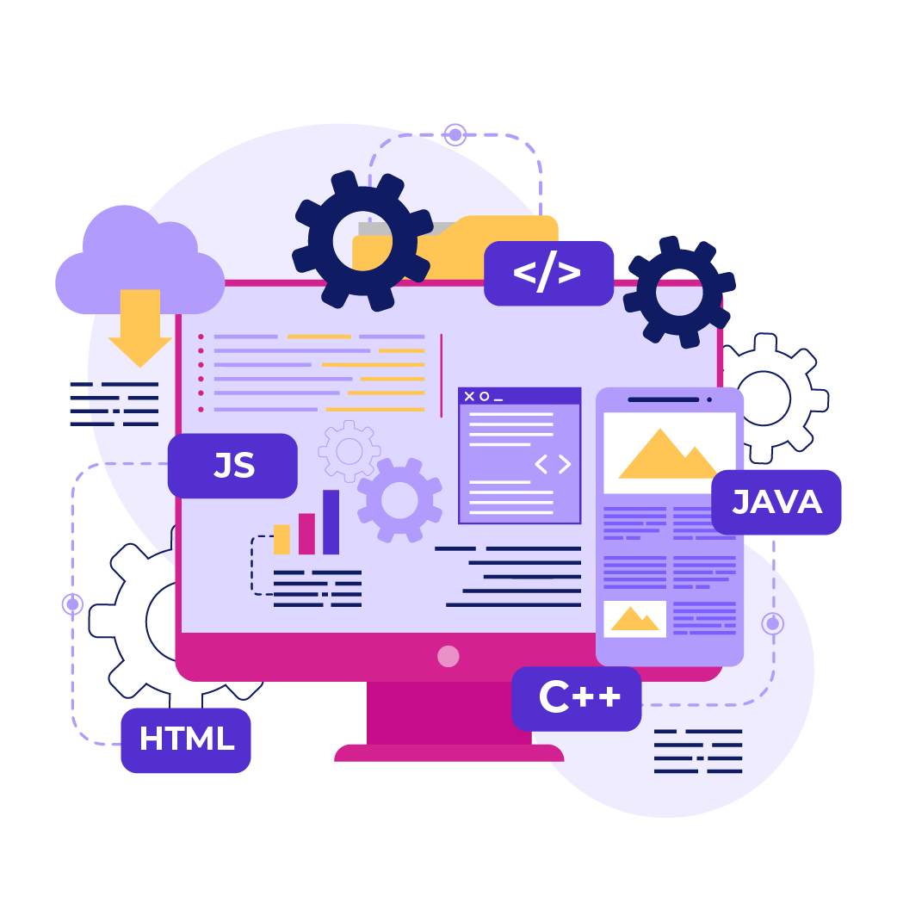
Introduction to
Computer
Programming

Slide 2

Types of Apps
(Web, Mobile, Desktop)

Slide 3
Differences between web apps, mobile apps, desktop apps
Feature | Web App | Mobile App | Desktop App
Runs On | Web Browsers | SmartPhones/ Tablets | PC or Laptop
Installation | Not Required | Installed via app stores | Installed via software centers
Examples | Gmail , Google Docs, Amazon.in | Amazon Mobile App | Microsoft Word , Photoshop

Slide 4
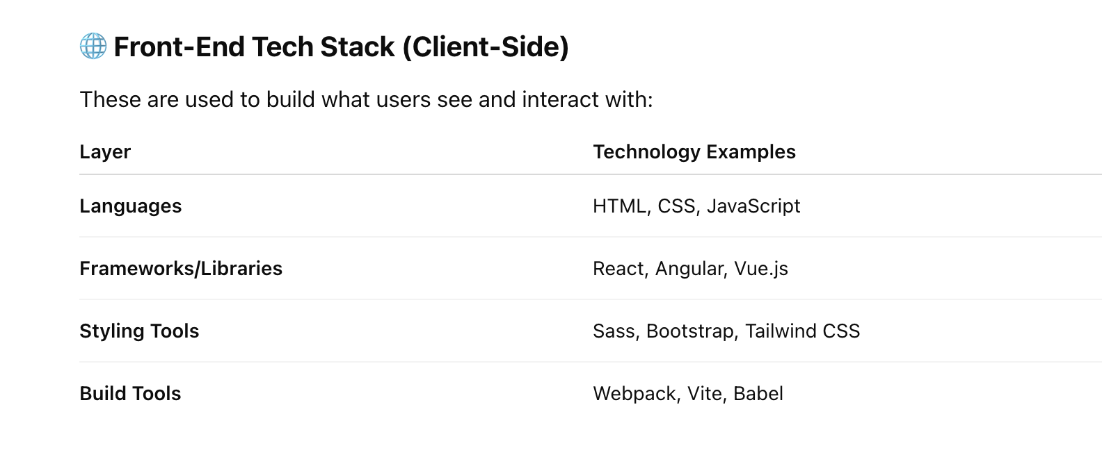
Front-end Tech Stack

Slide 5
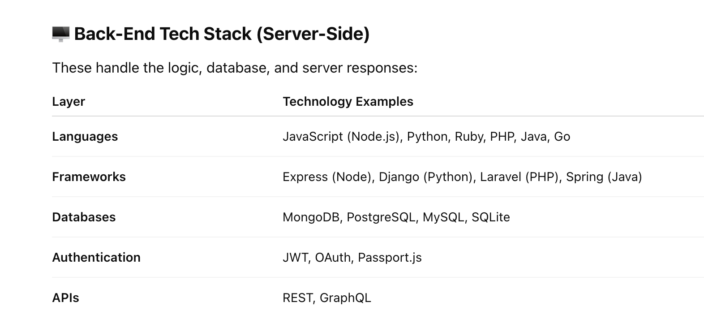
Backend Tech Stack

Slide 6
Backend Tech Stack

Slide 7

Real World Example
Lets play a game, what is amazon.in?

Slide 8
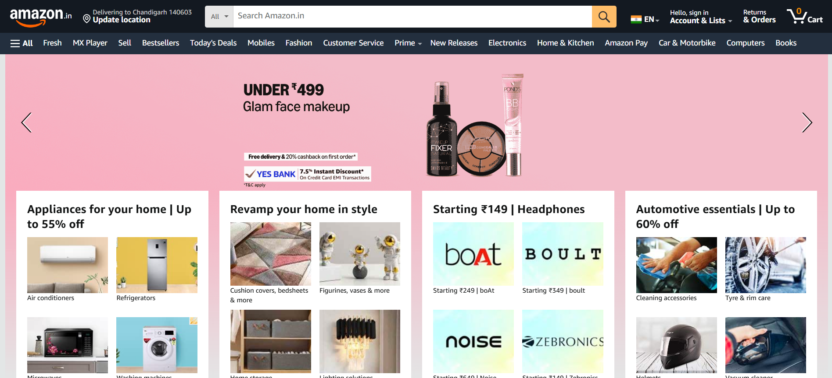
Real World Example
Yes, you are correct amazon.in is a web application.

Slide 9
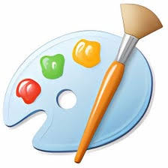
Real World Example
Okay , let's ask an another question !!!
What is MS Paint?

Slide 10
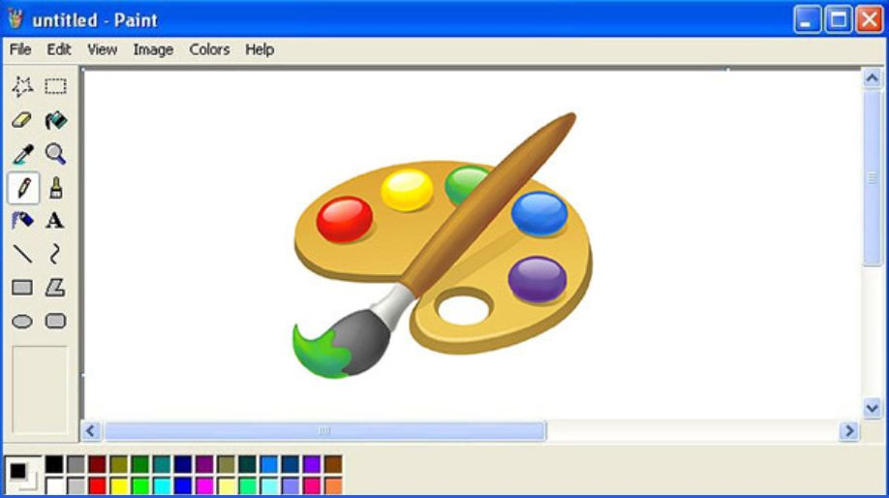
Real World Example
Yes, you are correct MS Paint is a desktop application.

Slide 11
Let's discuss more on real world examples !

Slide 12
THANK YOU

